Slide 1

FINANCE AND RISK ANALYSIS
Deer 2023
Presented By
Manasi Kaur
Priyanka Shah
Robert Mani

Slide 2

Agenda
01
Objective
02
Methodology
03
Insights and Visualization
04
Portfolio Analysis

Slide 3
OBJECTIVE
Analyse a portfolio of stocks to provide consultation on investment management based on client’s requirement. My task is to provide consultation to two different investors, Mr Patrick Jyenger and Mr Peter Jyenger based on their requirements and financial objectives.
Mr Patrick Jyenger wants to invest $500K in equities, he has been conservative investor during his all life and expects doubling his capital with less risk in 5 years time.
Mr Peter Jyenger wants to invest $1 million in equities, he has been high risk investor during his all life, prefers high return investment and expects doubling his capital with high risk in 5 years time.

Slide 4

METHODOLOGY
Deer 2023

Slide 5
EXPLORATORY DATA ANALYSIS:
Examined the dataset's Null values by examined the columns that contains null values.
Examined the dataset for outliers.
Imputed “0” for FB data as it was listed in NYSE on 18th May 2012.
DATA ANALYSIS:
Various calculations, including daily returns, cumulative daily returns, Sharpe ratios, portfolio risk, and return on investment (ROI), were used to analyze the stock data.
Discovered the finest stocks for all portfolios.
Used Power BI for better visualizations.
Performed sector wise analysis to get a better view of each sector.
INFERENCES AFTER ANALYSING THE DATA:
The stocks that gives best return among all stocks are AMZN, MSFT, AAPL, FB, UNH, GOOG and MS.
Each stock has different risk and reward according to its Annualized risk, Sharpe ratio and cumulative returns.
We found out that AMZN gives highest return among all stock but has high risk as compared to other stocks.
We also found that stocks like JNJ, RHHBY, MRK and MSFT have good returns with less risk.
By observing the sectors we understand that the best performing sector is Technology followed by Finance and the worst is Aviation followed by Health and Pharma.
So after doing all the analysis we have finalized the portfolio for both of our customers.

Slide 6

INSIGHTS AND VISUALIZATION
Deer 2023

Slide 7
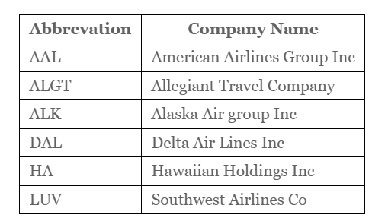
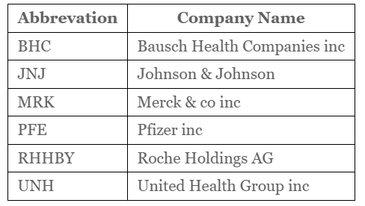
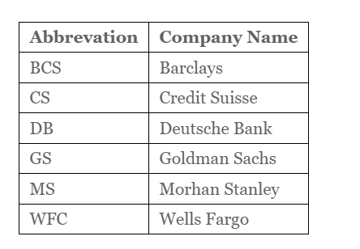
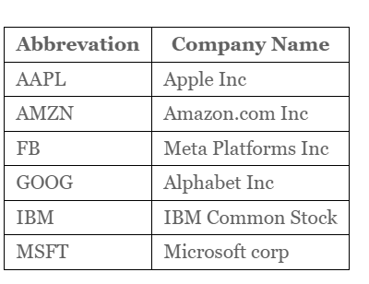
Stocks Data Available
Stocks from Aviation Stocks from Pharma Healthcare
There are 24 stocks available from four sectors containing 6 stocks from each sector.
There is an index available to compare the stocks outcome with. S&P500 is a combinations of top 500 stocks in US stock market.
This is the list of stocks with there abbreviation and Industry and company name.
Stocks from Finance Stocks from Technology

Slide 8
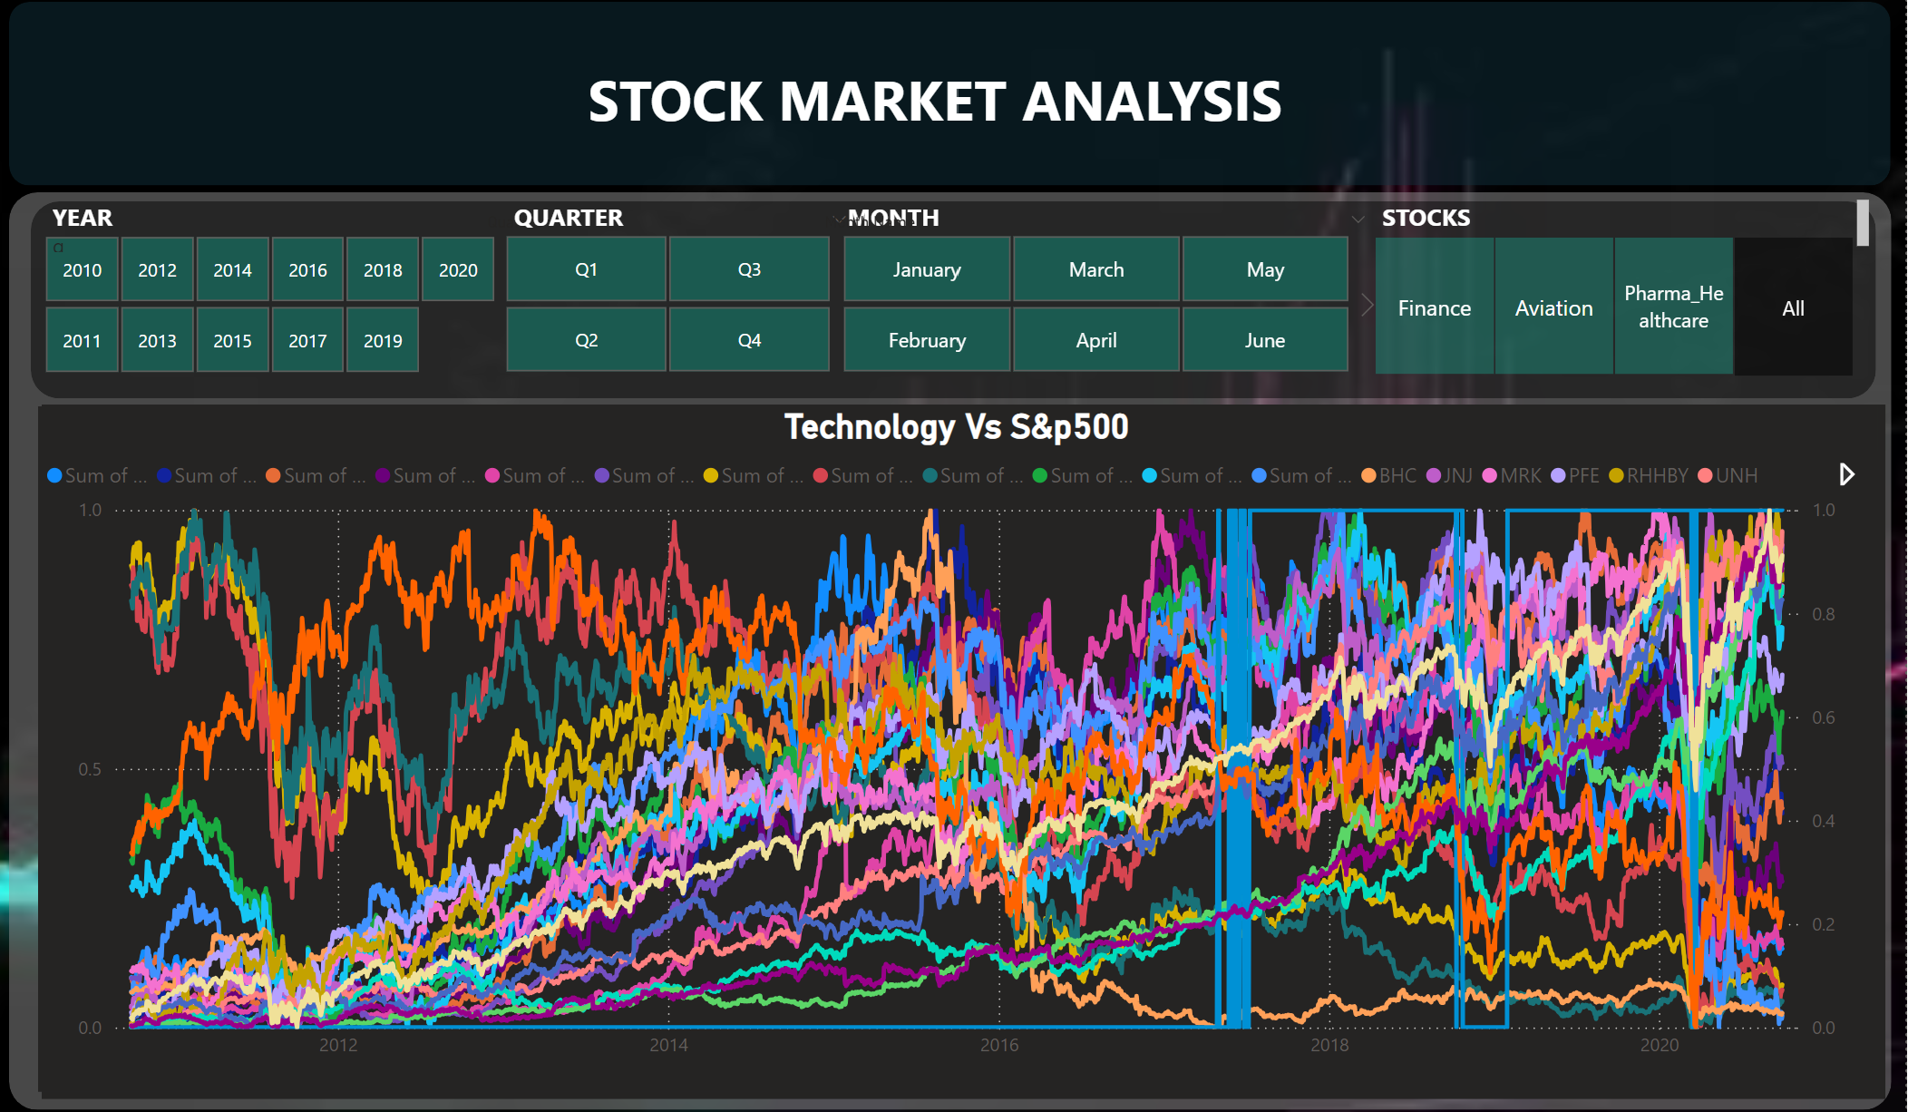
Visualization of Stocks after normalizing the values
The graph above illustrates how each stock has fared in relation to the S&P 500 index.
Here, we've compared the 10 years' worth of stock values for every stock.
We discovered that Facebook stock entered the market on May 18, 2012, when analyzing the stocks.
Additionally, we added buttons to our dashboard to enable sector-specific analysis.

Slide 9
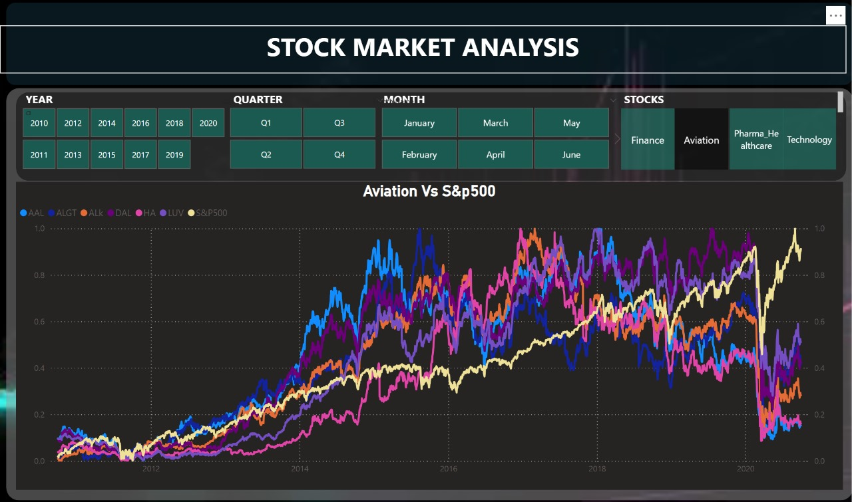
Sector Wise Analysis
Aviation Sector
There are 24 stocks available from four sectors containing 6 stocks from each sector.
S&P500 is not co-related to Aviation Sector.
Market took a massive hit in 2020 due to corona pandemic which resulted in a bear market.
Even though the market recovered but the Aviation Sector underperformed the market.
As we can see Allegiant Travel Company has some positive correlation with Delta Airlines.
Also we can see there is some positive correlation of Delta Airlines with Southwest Airlines.

Slide 10
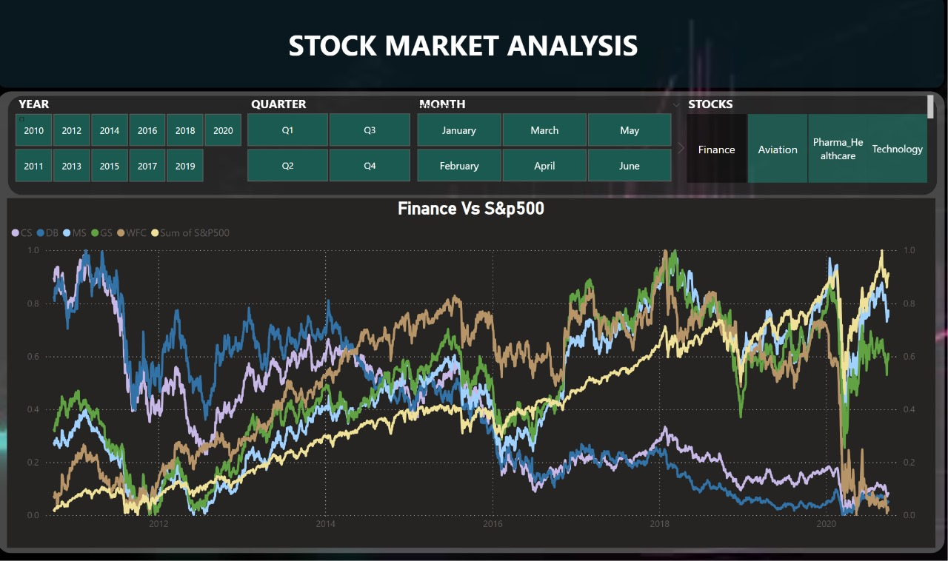
Sector Wise Analysis
Finance Sector
S&P500 is positively co-related with Finance Sector.
Although market took a massive hit in 2020 due to corona pandemic Morgan Stanley and Goldman Sachs were able to recover back as well as out performed the sector but still majority of stocks have been hit.
Also, we can see that Goldman Sachs & Morgan Stanley are highly correlated when compared to others stocks

Slide 11
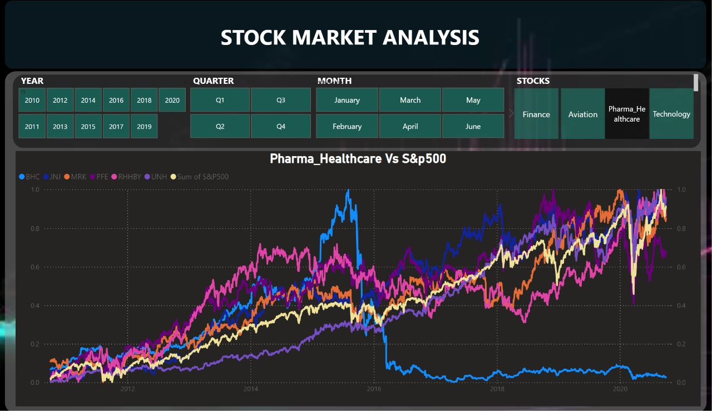
Sector Wise Analysis
Pharma and Healthcare Sector
S&P500 is positively co-related with Health and Pharma Sector(JNJ, MRK, UNH).
During the pandemic health and pharma and technology sector showed rapid growth after the market crash in comparison to other industries.
From past 5 years we can see that Bausch Health Companies inc has not seen any growth.
Overall the health and pharma sector is strong compared to S&P500.

Slide 12
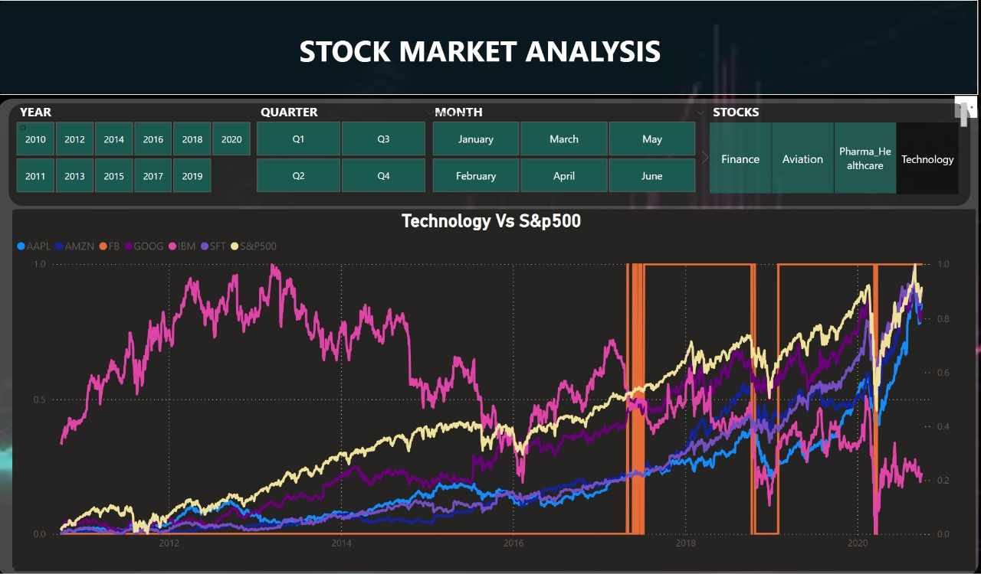
Sector Wise Analysis
Technology Sector
S&P500 is strongly co-related with Technology Sector(AMZN, FB, MSFT, GOOG, AAPL).
When compared to other sectors during the pandemic Tech sector was one of few sectors to bounce back sharply.
Except for IBM all the other stocks are out performing the market.
Also all the stocks except for IBM are strongly co-related with each other.

Slide 13
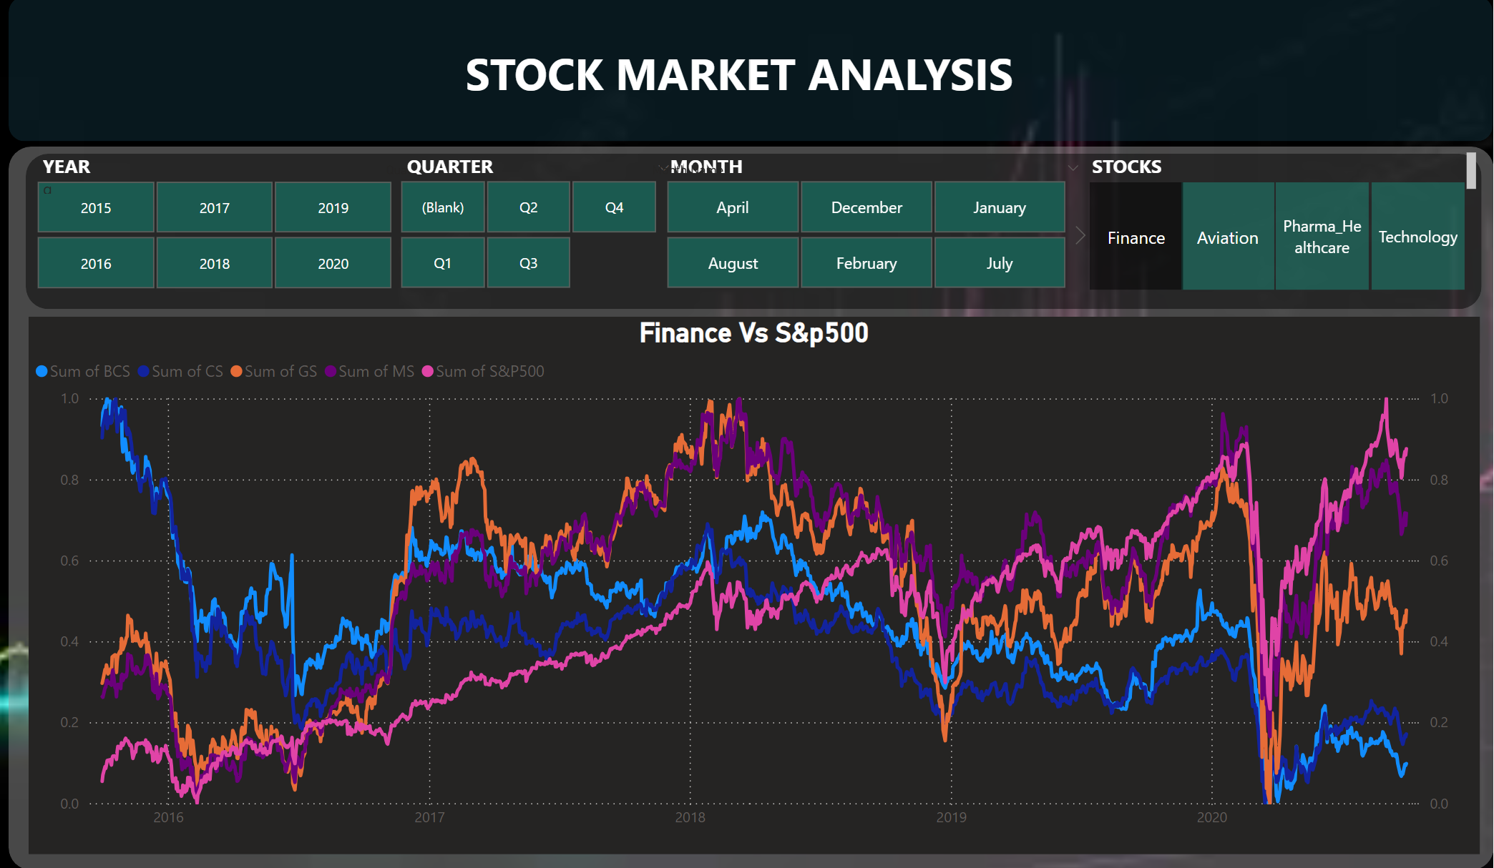
Visualization of Stocks for 5 years
As it was required to create visualization for 5 year analysis, we have created dashboard for the same as well.

Slide 14
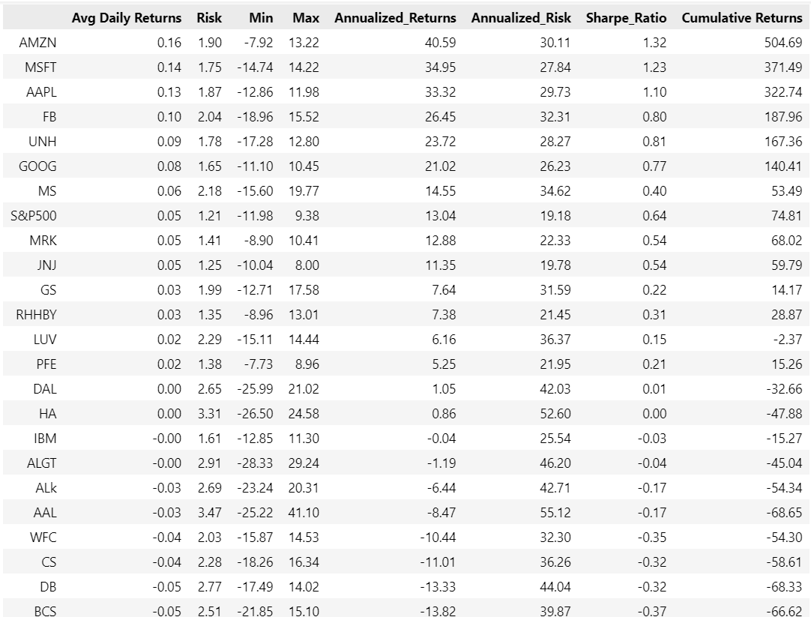
AMZN gives 40.59% annual returns.
MSFT gives 34.95% annual returns.
AAPL gives 33.32% annual returns.
FB gives 26.45% annual returns.
UNH gives 23.72% annual returns.
GOOG gives 21.02% annual returns.
MS gives 14.55% annual returns.
MRK gives 12.88% annual returns

Slide 15
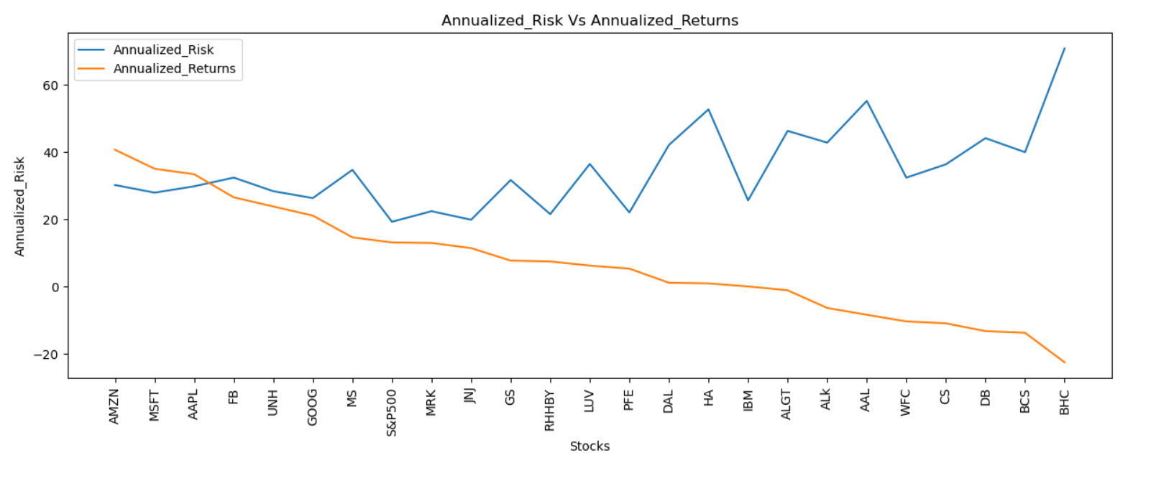
Annualized Return & Annualized Risk
The top five stocks by annualized return are AMZN, MSFT, AAPL, FB, and UNH.
The annualized return on each of the top 5 stocks is greater than 20. Compared to other equities, the risk of these five stocks is moderate.
The likelihood of losing money and depleting the initial investment increases with decreasing return.
Since they didn't even provide the return on investment as it was at the time of investing, the risk is larger for BHC, BCS, DB, CS, and WFC.
The riskier the company, the lower the ROI it offers, although there are some stocks that offer risk-free investment opportunities even if they don't offer the best returns.
JNJ, RHHBY, and MRK stocks offer a good return with minimal risk.

Slide 16

PORTFOLIO ANALYSIS
Deer 2023

Slide 17
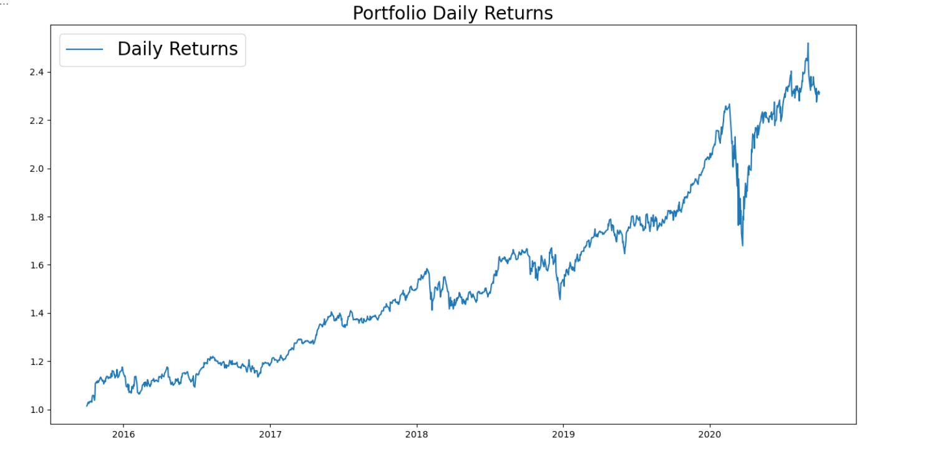
Patrick Jyengar Portfolio
In the next five years, Mr. Patrick Jyengar aims to double his investment. He seeks low-risk investments that will yield respectable profits.
As per his profile Low risk stocks like JNJ,RHHBY and GOOG is suitable to invest on. But overall returns with these three stocks wouldn't reach the target what Mr.Patrick is investing for. So one portion of his wealth can be invested on MSFT to gain the desired returns.
Keeping all stock weights equal, the overall weight is 0.25.
As Mr. Patrick Jyengar invests 5 Hundred Thousand Dollar in equities. The returns that he would get after 5 years of time period is 1.15 Million Dollar with more than 6 Hundred Thousand dollars of gain.

Slide 18
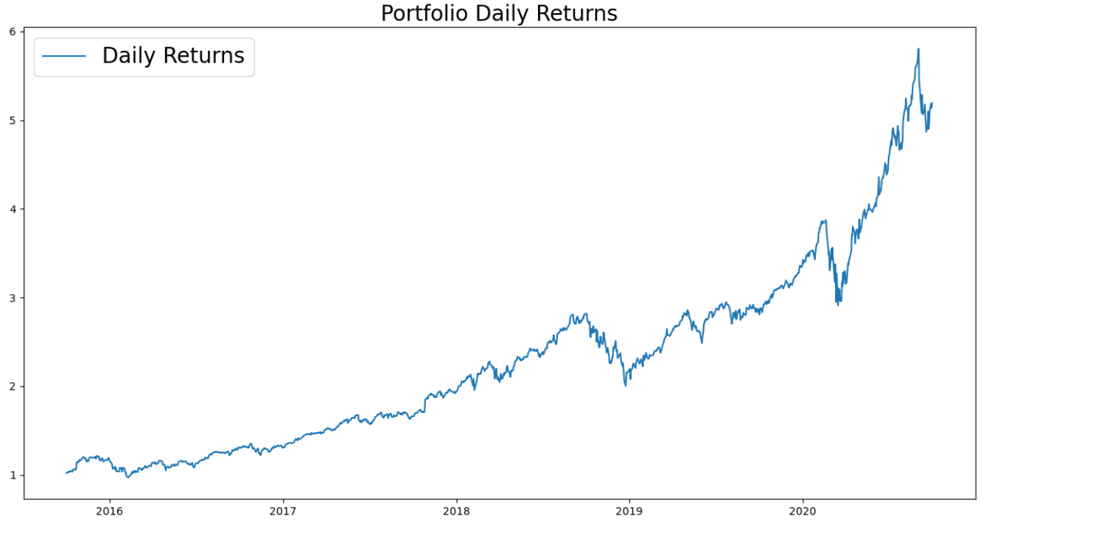
Peter Jyengar Portfolio
Mr. Peter Jyengar on the other hand Consistent with his attitude towards risk, he prefers high-return investments. Believes that he can still bounce back in case of any occasional losses.
He Wants to invest 1 million dollar from company's cash and cash equivalents in the most high-margin stocks Expects high returns within 5 years for inorganic expansion of his company.
As per his profile High risk/High Returns stocks like AMZN, MSFT and AAPL is suitable to invest on.
Overall returns with these stocks would fetch him Maximum returns and also cater the Risk.
As Mr. Peter Jyengar invests 1 Million Dollars in equities. The returns that he would get after 5 years of time period is more than 5 Million Dollars with more than 4 Million Dollars of gain.

Slide 19

THANKYOU
Deer 2023

